Slide 1
Computer Architecture & Assembly Language
CSC-250
COURSE LECTURE
COMPUTER SCIENCE DEPARTMENT
SIBAU KANDHKOT CAMPUS

Slide 2
What is a program?
A sequence of steps
arithmetic or logical operation is done
a different set of
control signals is needed

Slide 3
Function of Control Unit
A unique code for each operation
  Example: ADD, MOVE
Hardware Segment
Accept codes
Issues control signals

Slide 4
Computer Components
Computer
PC = Program Counter
IR = Instruction Register
MAR = Memory Address Register
MBR = Memory Buffer Register
I/O AR = Input/Output Address Register
I/O BR = Input/Output Buffer Register
Central Processing Unit (CPU)
PC
MAR
System
Bus
Main Memory
.
MBR
.
IR
.
0
1
2
.
.
.
I/O AR
Instruction
Execution Unit
Instruction
I/O BR
.
.
.
Data
I/O Module
Buffers
Data
.
.
.
.
.

Slide 5
Fetch Cycle
Program Counter (PC)
Holds address of next instruction to fetch
Processor
Fetch instruction from memory location pointed to by PC
Increment PC
Instruction Register (IR)
Load the instruction
Processor
Interprets instruction
Perform required actions

Slide 6
Execute Cycle
Processor I/O
Execution Cycle
Processor -Memory
Data Processing
Control

Slide 7
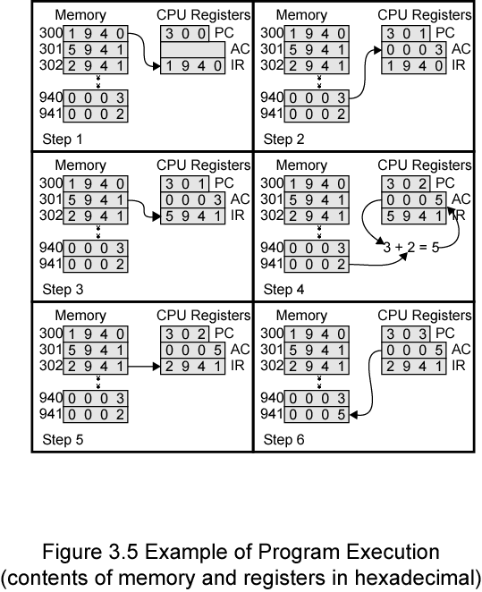
Addition Program Execution - Example

Slide 8
Instruction Cycle State Diagram
Instruction Fetch
Operand Fetch
Operand Store
Multiple Results
Multiple Operands
Instruction Address Calculation
Instruction Operation Decoding
Operand Address Calculation
Data Operation
Operand Address Calculation
Instruction complete, Fetch next instruction
Return for string or vector data

Slide 9
Interrupts
Mechanism by which other modules (e.g. I/O) may interrupt normal sequence of processing

Slide 10
Classes of Interrupts
Program
  Stack overflow, division by zero
Timer
  Generated by internal processor timer
  Used in pre-emptive multi-tasking
I/O
  I/O controller – signal the error condition
Hardware failure
  Power failure

Slide 11
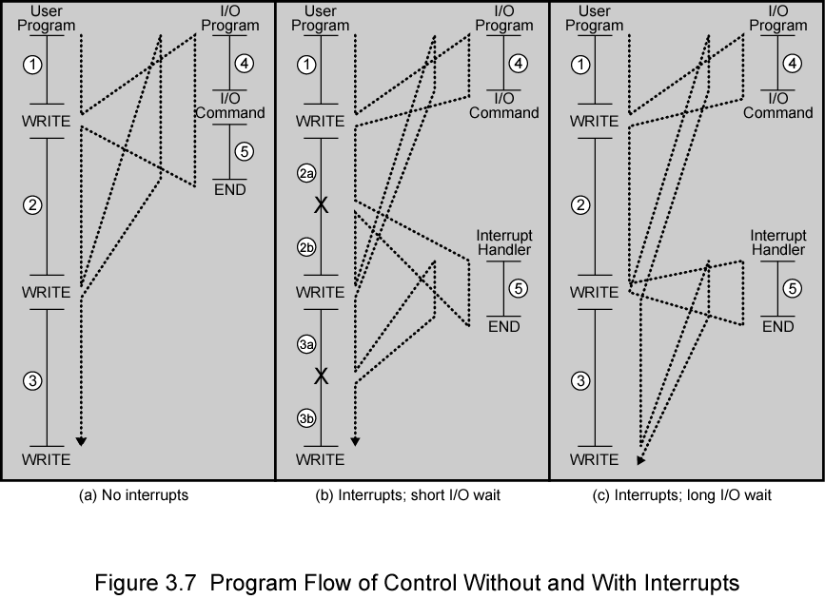
Interrupt – Program Flow Control

Slide 12
Interrupt Cycle
Added to instruction cycle
Fetch cycle
Execution cycle
Interrupt cycle
Interrupts disabled
Fetch Next Instruction
Execute Instruction
Check for interrupt; process interrupt
Start
Interrupts enabled
Halt

Slide 13
Interrupt Cycle (Cont.)
Processor checks for interrupt
  Indicated by an interrupt signal
If no interrupt, fetch next instruction
If interrupt pending:
  Suspend execution of current program
  Save context
  Set PC to start address of interrupt handler routine
  Process interrupt
  Restore context and continue interrupted program

Slide 14
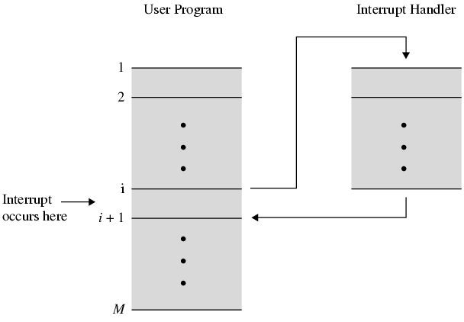
Transfer of Control via Interrupts

Slide 15
Multiple Interrupts - Approaches
Disable interrupts
  Processor - ignore that interrupt request signal
    Situation: executing the program and interrupt occurs – interrupts are disable immediately
  Pending - checked after the processor has enabled interrupts
    After interrupt handler routine completes
      Enable interrupts before resume
      Check additional interrupt
      Handle interrupt in strict sequential order

Slide 16
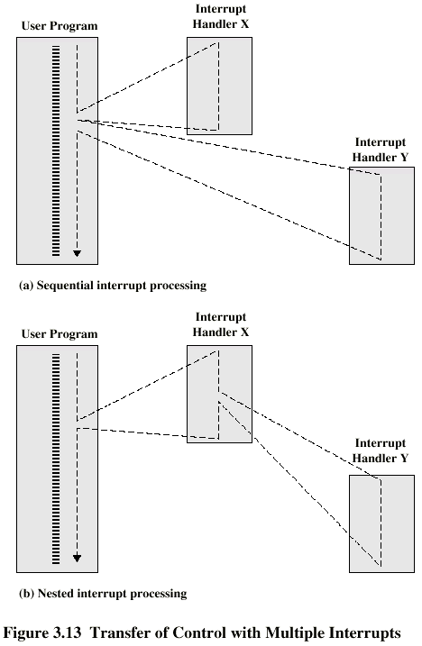
Multiple Interrupts – Sequential Interrupt Processing

Slide 17
Multiple Interrupts – Nested Interrupt Processing

Slide 18
Multiple Interrupts – Approaches (Cont.)
Define priorities
  Low priority interrupts can be interrupted by higher priority interrupts
  When higher priority interrupt has been processed, processor returns to previous interrupt

Slide 19
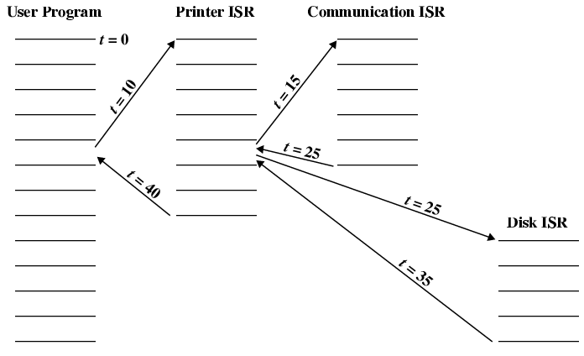
Time Sequence of Multiple Interrupts - Example

Slide 20
Time Sequence of Multiple Interrupts – Example
Step | t | Description
1 | 0 | Program begins
2 | 10 | Printer interrupt occurs Place user information on the system stack Execution continues at the printer interrupt service routine (ISR)
3 | 15 | Routine in (2) still executing Communication interrupt occurs ← higher priority than printer
4 | 20 | Routine in (3) still executing Disk interrupt occurs ← low priority than communication ISR but priority is higher than printer
5 | 25 | Communication ISR is completed Continue to execute disk ISR
6 | 35 | Disk ISR is completed Continue to execute printer ISR
7 | 40 | Routine completes Return to the user program

Slide 21
Interconnection Structures
Collection of paths connecting the various modules
Modules:
  Memory
  Processor
  I/O module

Slide 22
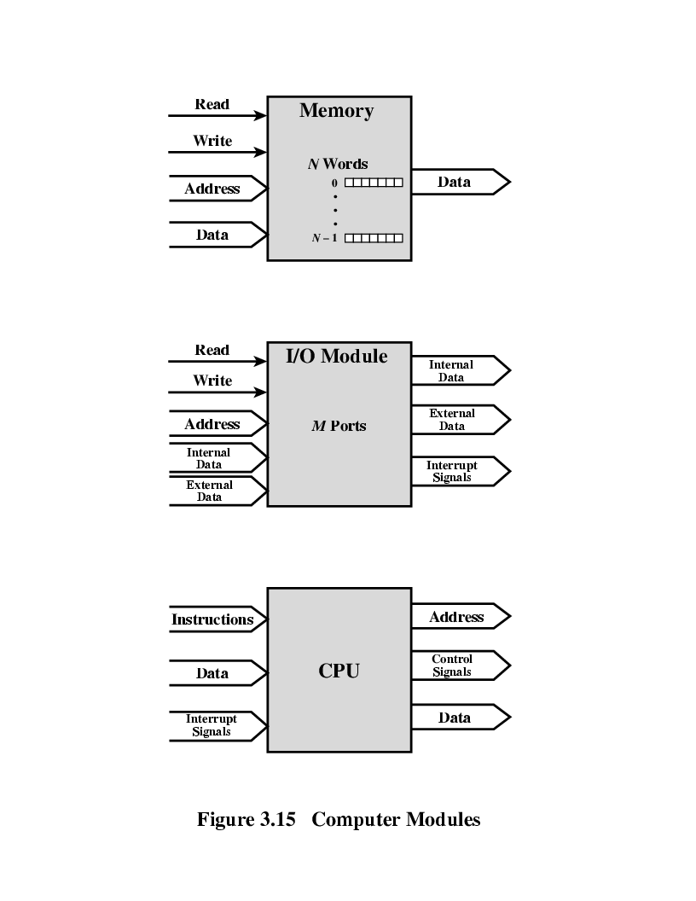
Modules: Major Form of Input and Output - Memory
Word of data - Read from or written into the memory
  Assigned a unique numerical address
Nature of the operation – indicated by read and write control signals
Address – specify the location for the operation

Slide 23
Modules: Major Form of Input and Output - Processor
Reads instruction and data
Writes out data (after processing)
Sends control signals to other units
Receives (& acts on) interrupts

Slide 24
Modules: Major Form of Input and Output – I/O Module
Operations;
  Read
  Write
Control more than one external device
External data path – input and output of data
Send interrupt signals to CPU

Slide 25
Modules:
Major Form of Input and Output

Slide 26
Types of Transfers
Memory to processor: Processor reads instruction/data from memory
Processor to memory: Processor writes data to memory
I/O to processor: Processor reads data from I/O device (via I/O module)
Processor to I/O: Processor sends data to I/O device
I/O to/from memory: allowed to exchange data using Direct Memory Access (DMA) – exclude processor

Slide 27
Bus Interconnection
Communication pathway connecting two or more devices
Key characteristic: shared transmission medium
Consists of multiple communication pathways/lines
  Lines – transmit signals representing binary 1 and 0 – one data at a time

Slide 28
System Bus
A bus that connects major computer components (CPU, memory, I/O)
Computer interconnection structures – use one or more system buses
Consists of 50 to hundreds of separate lines
  Each line – function. E.g: power

Slide 29
Data Line
Provide a path for moving data among system modules
Collective – data bus

Slide 30
Data Bus
Collective of data lines
Width of the data bus - Number of lines;
  32, 64, 128 …
  Key factor in determining overall system performance
Number of data lines – represents number of data can be transferred at a time

Slide 31
Address Lines
Designate the source or destination of the data on data bus

Slide 32
Address Bus
Collective of address lines
Width of the address bus determines the maximum possible memory capacity of the system

Slide 33
Control Lines
Used to control the access to and the use of the data and address lines
Control signals transmit both command and timing information among system modules
  Command signals – specify operations to be performed
  Timing signals – validity of data and address information

Slide 34
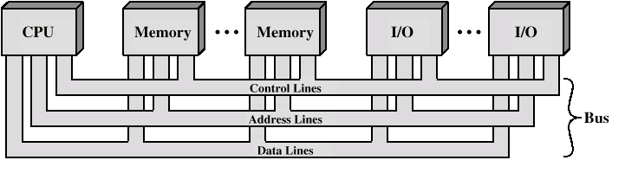
Bus Interconnection Scheme

Slide 35
Operation of the Bus
Send data
  Obtain the use of the bus
  Transfer data via the bus
Request data
  Obtain the use of the bus
  Transfer a request to the other module over appropriate control and address lines

Slide 36
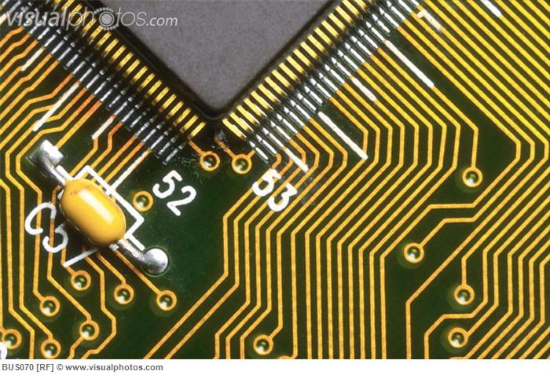
System Bus - Physical
Number of parallel electrical conductors – metal lines on the circuit board

Slide 37
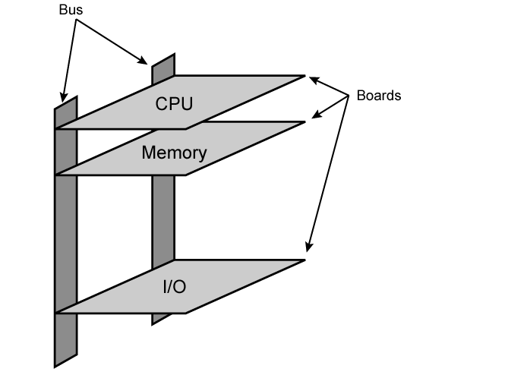
Physical Realization of Bus Architecture

Slide 38
Single Bus - Problem
Many of devices on one bus leads to:
  Propagation delays
    Long data paths mean that co-ordination of bus use can adversely affect performance
    If aggregate data transfer approaches bus capacity
Most systems use multiple buses to overcome these problems

Slide 39
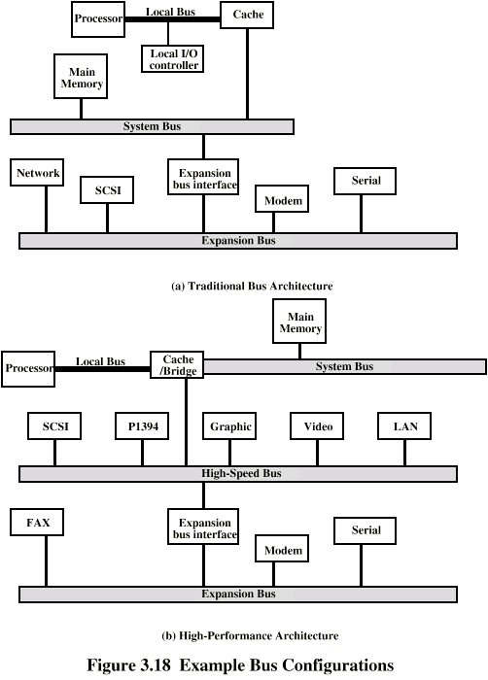
Traditional (ISA) - with cache

Slide 40
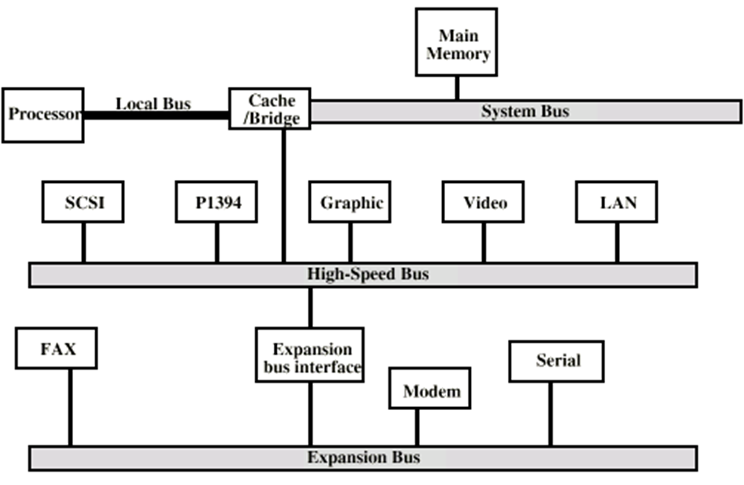
High Performance Bus

Slide 41
Types of Bus
Dedicated
  Separate data & address lines
Multiplexed
  Shared lines
  Address valid or data valid control line
  Advantage
    Fewer lines
  Disadvantages
    More complex control
    Reduction in performance

Slide 42
Bus Arbitration
Process of insuring only 1 devices places information onto the bus at a time
Master - slave mechanism
    Master is given control of the bus and can place information onto it
    Slave receives the information from the master
  Two methods
    Centralized
    Decentralized

Slide 43
Master–Slave Mechanism: Methods
Centralized
  Central bus controller mediates all device requests for the bus
  May be part of CPU or a hardware of its own (arbiter)
Decentralized
  No centralized controller
  All devices contain logic to control access to the bus

Slide 44
Bus Timing
Synchronous
  Occurrence of events on the bus is determined by the clock
  All events start at the beginning of a clock cycle
  Example: PCI bus (Peripheral Component Interface bus
Asynchronous
  The occurrence of one event follows and depends on the occurrence of a previous event
  More flexible than synchronous bus but more complicated as well
  Accommodates wider range of device speeds
  Example: Future bus+

